Slide 1

Apache Kafka

Slide 2
Overview
Kafka is a “publish-subscribe messaging rethought as a distributed commit log”
Fast
Scalable
Durable
Distributed

Slide 3
Messaging system
Point to point: message queue
Publish subscribe:messages are present in a topic
Producer ,consumer

Slide 4
Kafka adoption and use cases
LinkedIn: activity streams, operational metrics, data bus
400 nodes, 18k topics, 220B msg/day (peak 3.2M msg/s), May 2014
Netflix: real-time monitoring and event processing
Twitter: as part of their Storm real-time data pipelines
Spotify: log delivery (from 4h down to 10s), Hadoop
Loggly: log collection and processing
Mozilla: telemetry data
Airbnb, Cisco, Gnip, InfoChimps, Ooyala, Square, Uber, …

Slide 5
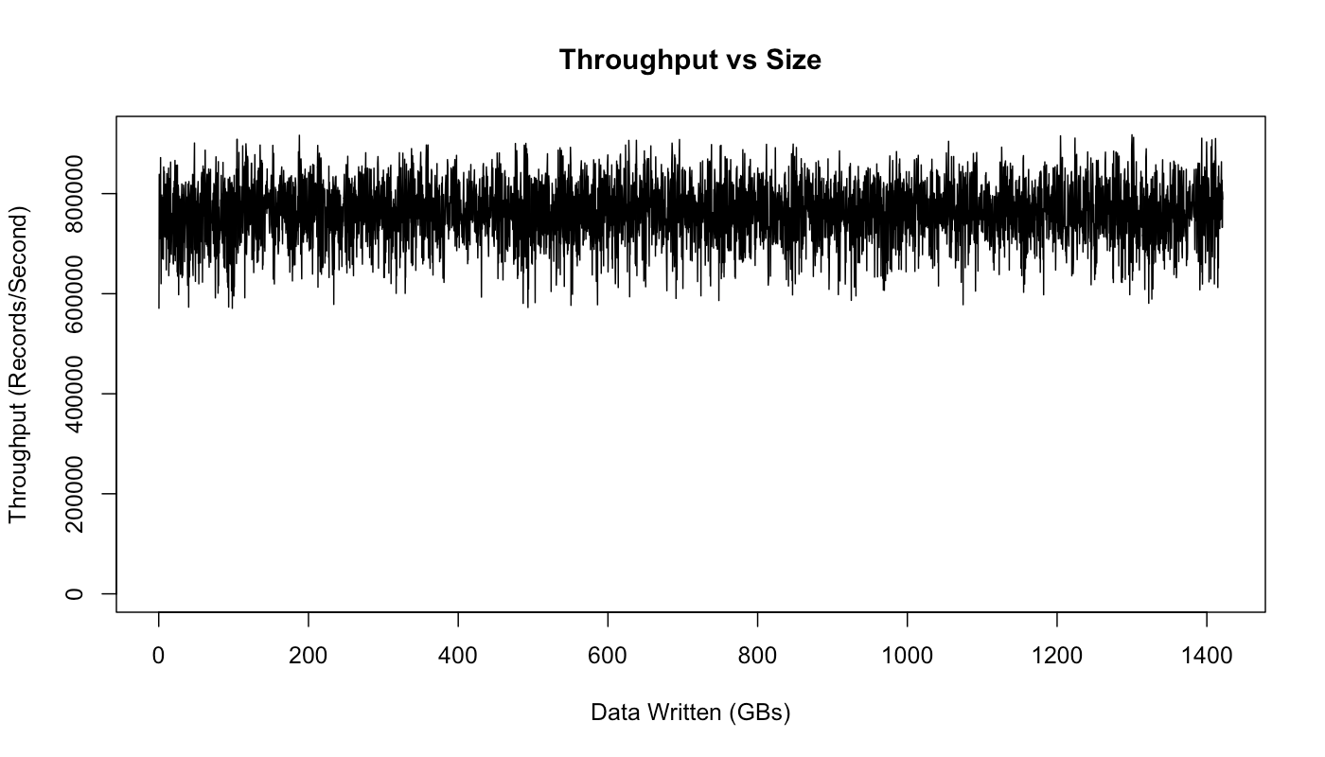
How fast is Kafka?
“Up to 2 million writes/sec on 3 cheap machines”
Using 3 producers on 3 different machines, 3x async replication
Only 1 producer/machine because NIC already saturated
Sustained throughput as stored data grows
Slightly different test config than 2M writes/sec above.

Slide 6
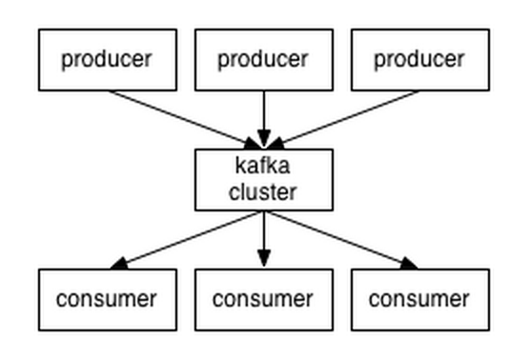
A first look
The who is who
Producers write data to brokers.
Consumers read data from brokers.
All this is distributed.
The data
Data is stored in topics.
Topics are split into partitions, which are replicated.

Slide 7
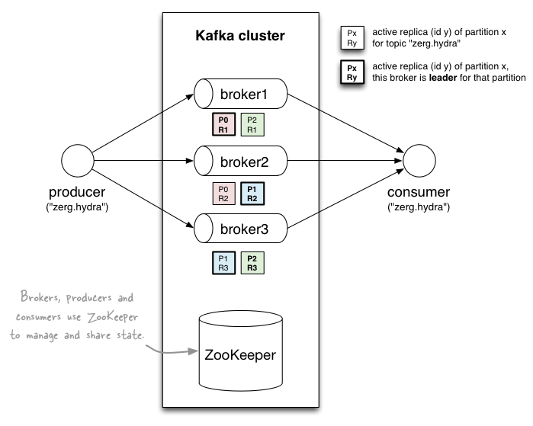
A first look

Slide 8
Topics
Topic: feed name to which messages are published
Producer A1
Kafka topic
Producer A2
…
…
new
Producer An
Older msgs
Newer msgs
Producers always append to “tail”
(think: append to a file)
Broker(s)

Slide 9
Topics
Consumer group C1
Consumers use an “offset pointer” to
track/control their read progress
(and decide the pace of consumption)
Consumer group C2
Producer A1
Producer A2
…
…
new
Producer An
Older msgs
Newer msgs
Producers always append to “tail”
(think: append to a file)
Broker(s)

Slide 10
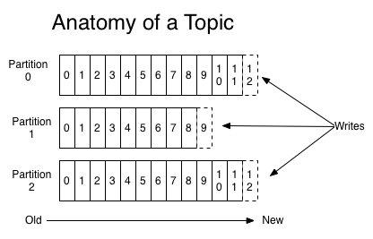
Partitions
A topic consists of partitions.
Partition: ordered + immutable sequence of messages that is continually appended to

Slide 11
Kafka producer---write message—broker---consumer
Broker---contains—topics---collection of message..

